Slide 1









My Linear Equations Interactive Notebook
$$×$$
$$\frac{1}{2}$$
$$÷$$
$$+$$
$$−$$
$$\frac{3}{5}$$
$$7$$
Name
Class
Teacher
Term 1 Semester 1
$$5^{2}$$
$$\sqrt{9}$$
1

Slide 2
Contents
Glossary or Formula Page
Page
Date
Description
2
3

Slide 3
Tasks
24
7
30
Essential Question
Questions
Notes
Summary
6
7

Slide 4
24
7
30
Date
Simultaneous Equations
EQ – How do I find the point of intersection by Elimination?
7

Slide 5
24
7
30
Date
Simultaneous Equations
EQ – How do I find the point of intersection by Elimination?
In the elimination method you make the coefficients of one variable the same by multiplying the equations by suitable constants. The coefficient in one equation is the same size as the other equation. Then add or subtract the equations to make an equation with only one variable. Solve this and find the other value.
Eliminate!!
or as in Dr Who
Exterminate!
Solve this pair of simultaneous equations by elimination.
2b – a = 3 [1]
a + 3b = 7 [2]
Rewrite equation 1 like this -a + 2b = 3
Because I have a +ve and –ve a in equations 1 & 2 we can add them
-a + 2b = 3 [1]
+(a + 3b = 7) [2]
0a + 5b = 10 .
b = 2
Now substitute b = 2 into equation 1 or 2
a + 3*(2) = 7
a = 7 - 6
a = 1
∴ a = 1 and b = 2 or written as (1,2)
Same equations as yesterday
0a not needed here it just becomes 5b = 10
7

Slide 6
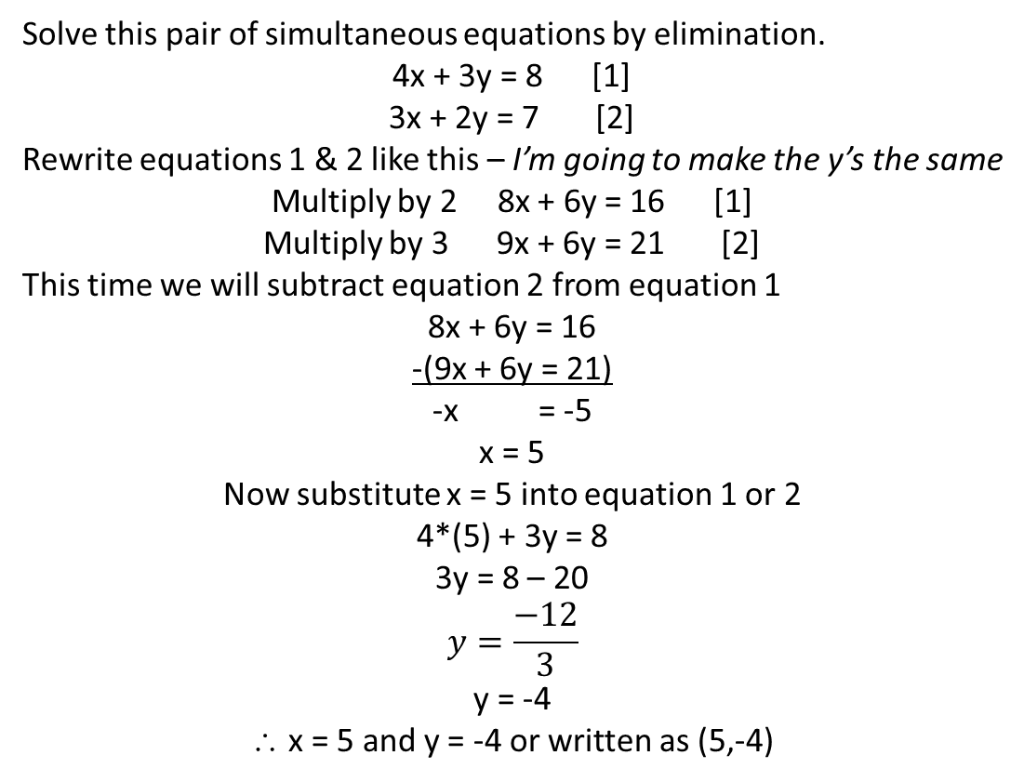
24
7
30
Date
Simultaneous Equations
EQ – How do I find the point of intersection by Elimination?
Eliminate again but a bit harder
Solve this pair of simultaneous equations by elimination.
4x + 3y = 8 [1]
3x + 2y = 7 [2]
Rewrite equations 1 & 2 like this – I’m going to make the y’s the same
Multiply by 2 8x + 6y = 16 [1]
Multiply by 3 9x + 6y = 21 [2]
This time we will subtract equation 2 from equation 1
8x + 6y = 16
-(9x + 6y = 21)
-x = -5
x = 5
Now substitute x = 5 into equation 1 or 2
4*(5) + 3y = 8
3y = 8 – 20
$$y=\frac{−12}{3}$$
y = -4
∴ x = 5 and y = -4 or written as (5,-4)
Again using the same equations as yesterday
Need to have the coefficients of the x’s or the y’s the same
7

Slide 7
24
7
30
Date
Simultaneous Equations
EQ – How do I find the point of intersection by Elimination?
A school play was attended by a total of 400 people. Adults were charged $5 and children $2. Ticket receipts were $1100. How many adults and children attended?
Problem Solving!
2a + 2c = 800
- (5a + 2c = 1100)
-3a = -300
a = 100
Mult by 2
And subtract
Adults + Children = 400
a + c = 400
Substitute a = 100 into the first equation
100 + c = 400
c = 300
$5*adults+ $2*child = 1100
5a + 2c = 1100
Don’t forget this is your answer!!!
We have 100 adults and 300 children in attendance.
7

Slide 8
Exercises
Exercise 2.8 from Dwyer
All to be done with a smile on your faces.
Those who need to do the OLNA test have a go at the sample OLNA questions on connect

Slide 9
Notes Review
24, 7 ,30
Date
Title
Essential question
Notes complete
Notes complete with colour and diagrams
Questions completed
Contents page filed in
Formula page filled in

Slide 10
Homework
Review your notes and write a summary answering the essential question.

